Slide 1
Visual Question Answering

Slide 2



MEET THE TEAM
Yusuf Gamal
Bishoy Aboelsaad
Hazem Abbas
Data Scientist
Data Scientist
AI Engineer
usef.g.abdelmonim@gmail.com
beshoy.abdel_masieh@yahoo.com
hazemabbas6@gmail.com
0 109 952 0579
0 122 694 4977
0 101 582 0270
github.com/UsefGamal/
github.com/BeshoAbdo173
github.com/Hazem-Abbas

Slide 3
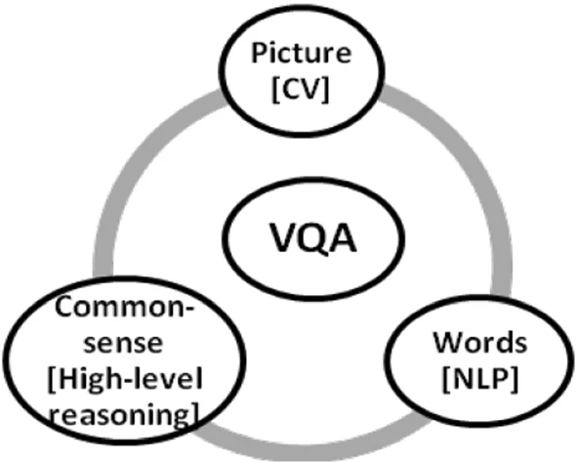
What is VQA ?
Is a research area about building a computer system to answer questions presented in an image and a natural language.

Slide 4
Task subproblems
The problem has widely been accepted as Artificial General Intelligence problem.
CV Task |  | Representative VQA question
Object Recognition |  | What is in the image ?
Object Detection |  | Are there any dogs in the picture?
Attribute Classification |  | What colour is the umbrella?
Scene Classification |  | Is it raining?
counting |  | How many people are there in the image?
Activity Recognition |  | Is the child crying?
Spatial Relationships Among Objects |  | What is between cat and sofa?
Common-sense Reasoning |  | Does this person have 20/20 vision?
Knowledge-Base Reasoning |  | Is this a vegetarian pizza?

Slide 5
Solution Steps
Image featurization
converting images into their feature representations for further processing.
Question featurization
converting natural language questions into their embeddings for further processing.
Joint feature representation
ways of combining image features and the question features to enhance algorithmic understanding.
Answer generation
utilizing the joint features to understand the input image and the question asked, to finally generate the correct answer.

Slide 6
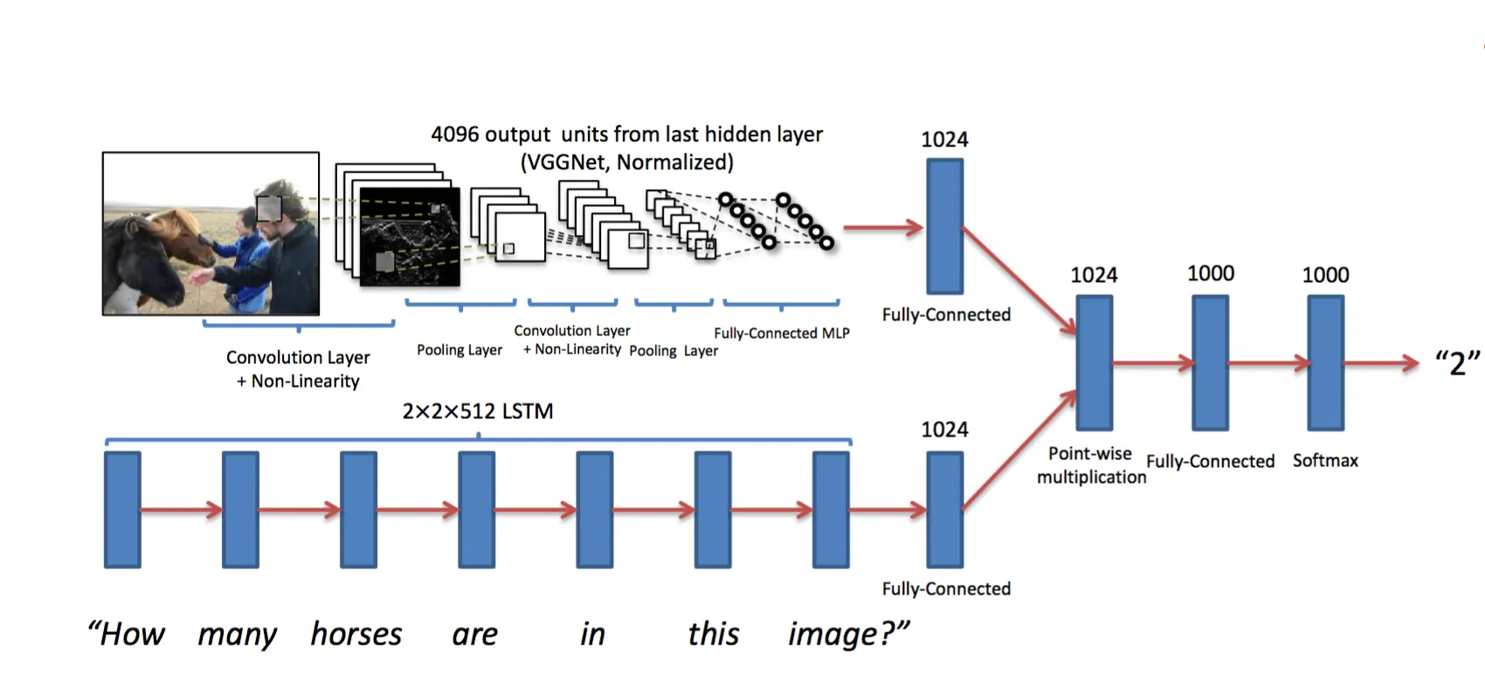
generic model for Visual Question Answering

Slide 7
VQA 2.0 Dataset
VQA Input Images
Training Images: 82,783 images | Validation images: 40,504 images | Testing images: 81,434 images
VQA Input Questions
Training Questions: 443,757 questions | Validation Questions: 214,354 questions | Testing Questions: 447,793 questions
VQA Annotations
Training Annotations: 4,437,570 answers | Validation Annotations: 2,143,540 answers

Slide 8
Solution Approaches

Slide 9
TWO-Way Approaches
VGG19 + LSTM
INCEPTIONv3 + LSTM
INCEPTIONv3 + GRU
GENERIC MODEL
31.56
37.2
42.78
PRETRAINED MODEL
69.07
BERT + EFnet B2
VILT

Slide 10
Challenges
Dataset Size
Mapping Features for questions
Computing such size for data was exhausting for machine so we did batch them
Every image was related to 3 or more questions and each question was related to 10 answers
Computation and Size Limitation
Due to number of images and complexity of extracting the features , we saved and reloaded features to fitting the model

Slide 11
Demo

Slide 12
Future work
Improving performance on challenging questions
Handling more complex visual scenes
Interactive Learning System
X-ray diagnostic system

Slide 13
THANK YOU

